Slide 1

Deep learning system for paddy plant disease detection and classification

Slide 2
Introduction
Brief on the significance of rice disease detection.
Focus on five major diseases impacting paddy crops.

Slide 3
Methodology Overview
Concise steps: Acquisition, Augmentation, Pre-processing, Segmentation, Feature Extraction, Classification.
Diseases targeted: Brown leaf spot, leaf blast, sheath rot, false smut, bacterial blight.

Slide 4
Data Preparation
Collection of field images from Kerala.
Application of data augmentation techniques for diverse training sets.

Slide 5
Image Processing Techniques
Importance of removing noise: dust, water drops, shadows.
Overview of segmentation methods: region-based, edge detection, clustering, Mask R-CNN.

Slide 6
Feature Extraction
Significance of features in image processing.
Types of features: Global and local feature descriptors.

Slide 7
SVM Model Evaluation
Initial accuracy: 67%, improved to 75% with hyperparameter tuning.
Visualizing SVM's training and validation scores for different gamma values.

Slide 8
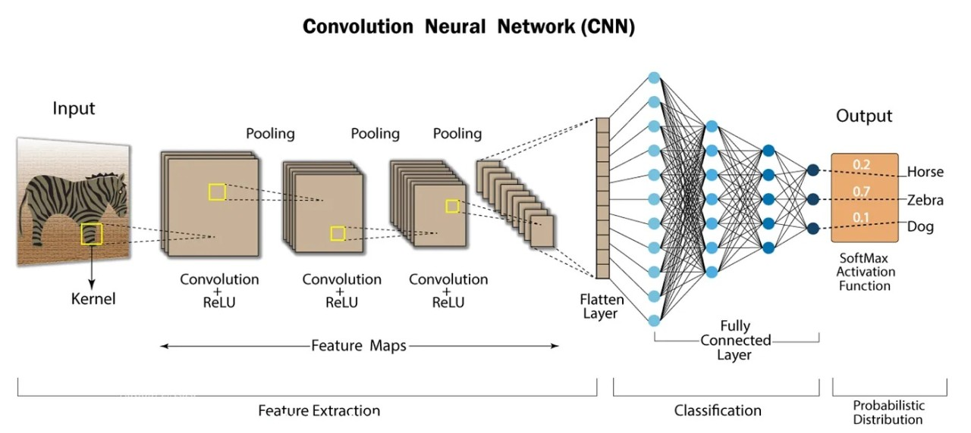
CNN Superiority
CNN outperforms SVM: Higher validation and test accuracies.
Evaluation of different activation functions.
Key insight: Rectified Linear Unit (ReLU) and Parametric ReLU (PReLU) perform exceptionally well.

Slide 9
Future Directions
Suggestions for future improvements.
Integration of advanced deep learning techniques.
Utilizing GIS technologies for crop yield estimation.

